Slide 1
jQuery Jubilee
Lesson 5.2

Slide 2
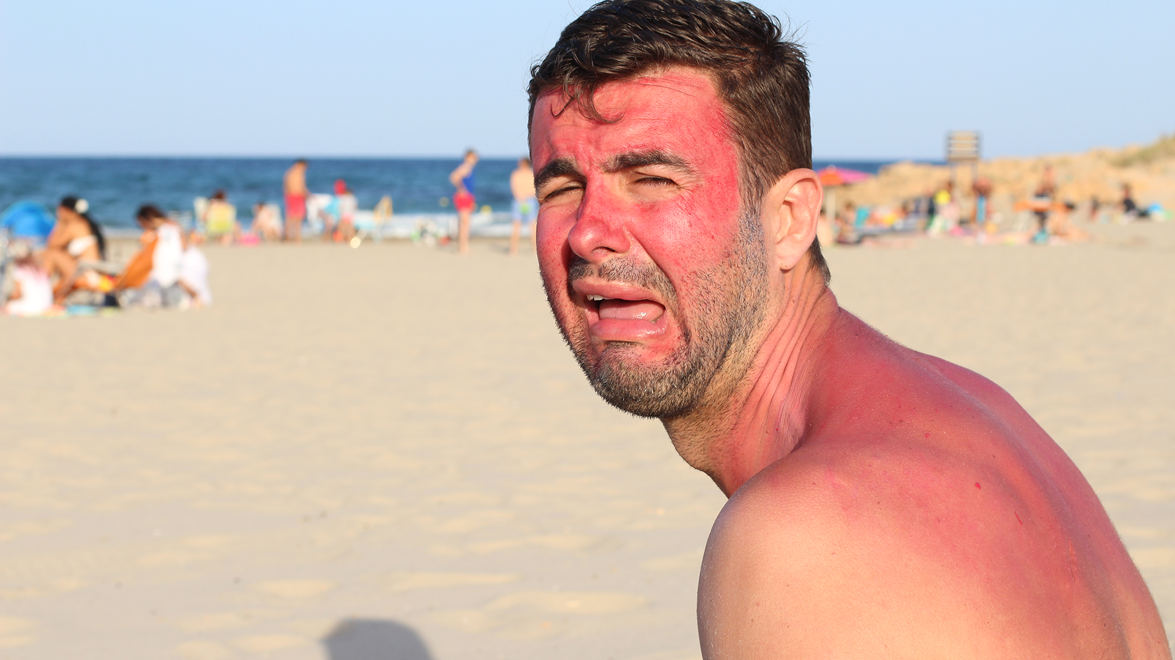
This shouldn’t be you:
Notes:
shutterstock_1128769874

Slide 3

Remember This:
You can’t tell whether you’re learning something when you’re learning it—in fact, learning feels a lot more like frustration.
What I’ve learned is that during this period of frustration is actually when people improve the most, and their improvements are usually obvious to an outsider. If you feel frustrated while trying to understand new concepts, try to remember that it might not feel like it, but you’re probably rapidly expanding your knowledge.
—Jeff Dickey, author of Write Modern Web Apps with the MEAN Stack: Mongo, Express, AngularJS, and Node.js

Slide 4
Important Reminders
This course covers a lot of material quickly, so remember:
Instructors and TAs are here to help.
Feel encouraged to schedule a one-on-one during office hours.
One-on-one sessions are a great way to identify weaknesses and outline a plan to get back on track.
Office hours are held before and after class.

Slide 5
Today’s Class

Slide 6
Objectives
Use jQuery DOM manipulation to create simple games.
Practice jQuery on Captain Planet: The Game and Fridge Game.
Gain an initial understanding of lexical scope in JavaScript.
Understand click events.

Slide 7
Captain Planet: The Game!

Slide 8

Captain Planet: The Game!
Superpowers: Change Sizes!
Superpowers: Invisibility
Move Controls
Normal
Grow
Shrink
Visible
Invisible
Go Planet!
Notes:
shutterstock_391065901

Slide 9
Captain Planet: The Game!
jQuery Jubilee

Slide 10
Group Activity: Pseudocode Captain Planet
7 minutes
jQuery Jubilee

Slide 11
Group Activity: Pseudocode Captain Planet
Suggested Time: 7 minutes
Examine the code for the Captain Planet game. Then, describe how this code works in five steps.
1.
2.
3.
4.
5.
jQuery Jubilee

Slide 12
Pseudocoding Captain Planet
Solution:
Create an initial HTML layout using Bootstrap.
Add a reference to jQuery.
Assign unique class names to key buttons and images.
Use jQuery to capture when the corresponding buttons are clicked, using the $() identifier with the class name inside.
Create code that changes the CSS of target classes in response to click events.
jQuery Jubilee

Slide 13
Activity: Create a Captain Planet Superpower
12 minutes
jQuery Jubilee

Slide 14
Activity: Create a Captain Planet Superpower
Suggested Time: 12 minutes
Review the jQuery API documentation (api.jquery.com). Then, add a button of your own that gives Captain Planet a new power.
Examples:
Click to…stretch Captain Planet.
Click to…trigger a maniacal laugh.
Click to…create clones of Captain Planet.
Click to…create a shield (hint: border).
Click to…create fire or water (hint: images).
jQuery Jubilee

Slide 15
jQuery Recap
jQuery Jubilee

Slide 16

jQuery in a Nutshell
01
Find some HTML.
02
Attach to an event.
03
Do something in response.
jQuery Jubilee

Slide 17
jQuery in a Nutshell
We use the jQuery $( ) identifier to capture HTML elements:
Then, we tie the element to a jQuery method of our choice to capture events:
Finally, we modify the selected element or add or remove elements from the DOM:
$(“.classname”) | $(“div”)
$(“#idname”) | $(“p”)
.on(“click”) | .ready()
.animate() | .append() | .remove()
jQuery Jubilee

Slide 18
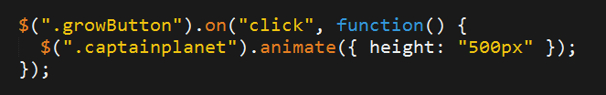
jQuery: A Common Example
01
02
Click the Grow button.
Make Captain Planet grow.
Superpowers: Change Sizes!
Normal
Grow
Shrink
jQuery Jubilee
Notes:
shutterstock_391065901

Slide 19
Use Documentation When Needed:
api.jquery.com
jQuery Jubilee

Slide 20
Group Challenge: Fridge Game
35 minutes
jQuery Jubilee

Slide 21


Group Challenge: Fridge Game
Suggested Time: 35 minutes
Working in groups of three, complete the code for the fridge game such that:
JavaScript dynamically generates buttons for each of the letters on the screen.
Clicking any of the buttons causes the same letter to be displayed on the screen.
Clicking the Clear button erases all of the letters from the fridge.
Note: This is a challenging activity. You may want one person in the group to type the code while the other two watch to catch bugs and research code snippets when necessary.
jQuery Jubilee

Slide 22
Crystal Collector
jQuery Jubilee

Slide 23
Lexical Scope
jQuery Jubilee

Slide 24
This next section is heavy on theory.
jQuery Jubilee

Slide 25
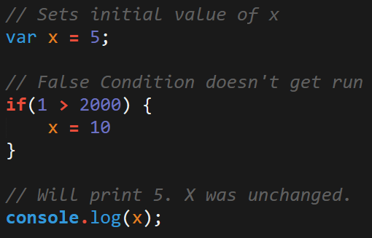
JavaScript Scope
In Javascript, curly brackets { } indicate blocks of code.
In order for the code inside the curly brackets to be executed, it must meet the condition or be called (example: functions).
These blocks of code can affect variables that were declared outside the curly brackets—so be careful!
jQuery Jubilee

Slide 26
Scope = Boxes in Boxes
Scope impacts which variables can be accessed by which function.

Slide 27
Scope = Boxes in Boxes
function global()
function inner()
function eveninner()
function innest()

Slide 28
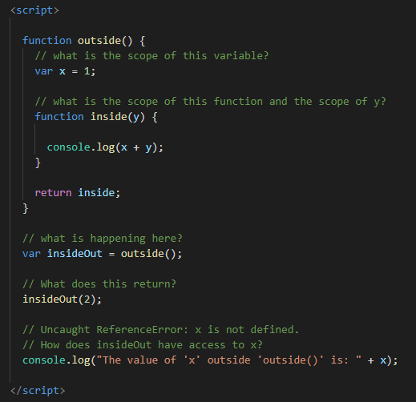
JavaScript Scope Example
Here, inside is clearly able to access the variables of its parent function, outside.
How does insideOut have access to x?

Slide 29
Activity: Lexical Scope 1
10 minutes

Slide 30
Activity: Lexical Scope 1
Suggested Time: 10 minutes
Review the file sent to you and explain the following to the person sitting next to you:
What do the terms parent function and child function mean?
Why can child functions access parent variables, but not vice versa?
Be prepared to share your answers!

Slide 31
Activity: Lexical Scope 2
7 minutes

Slide 32

Activity: Lexical Scope 2
Suggested Time: 7 minutes
Take a few moments to dissect the code just sent to you.
Try to predict what will be printed in each of the examples.
Be prepared to share!
Note: Pay attention to the unusual use of the keyword this.

Slide 33
Lexical Scope 2

Slide 34
Activity: Lexical Scope 3
7 minutes

Slide 35
Activity: Lexical Scope 3
Suggested Time: 7 minutes
Take a few moments to dissect the code just sent to you.
Try to predict what will be printed in each of the examples.
Be prepared to share!
Note: Pay attention to the unusual use of the keyword this.

Slide 36

Yep, I don't understand.
Notes:
shutterstock_678350425

Slide 37
If you’d like to learn more, here’s a helpful article:
What You Should Already Know about JavaScript Scope
spin.atomicobject.com

Slide 38
Challenge:
Color Corrector: Build a Brain Teaser
20 minutes plus additional 20 minutes at home

Slide 39
Color Corrector: Build a Brain Teaser
Choose the color of the word shown from the list below:
teal
brown magenta blue teal coral black

Slide 40
Challenge: Color Corrector: Build a Brain Teaser
Suggested Time: 20 minutes
Using the files sent to you as a starting point, add the missing code so that the Color Corrector game works correctly.
To win, choose the word that matches the color of the text at the top of the column.
Example:
brown
teal coral black brown magenta blue
brown
teal coral black brown magenta blue

Slide 41
Questions?

